Slide 1
Unity – Simple Animations
Mr. Neat

Slide 2
Recipe to make a simple Animation
Make a sprite sheet
These are individual images, stored as png’s, with no background
Like a flip-o-rama

Slide 3


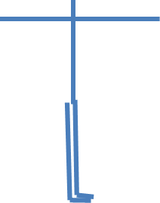
Sprite Sheet Generation
make independent images
store each as png file
insert pictures back into ppt
store slide as png

Slide 5
Sprite Sheet : remove background
use website lunapic.com
select edit
select transparent
Load picture
click on your image background
click apply threshold
save file (gif)
(background is gone!)

Slide 6
Sprite Sheet – load into Unity
Import new asset (gif,png)
Change inspector sprite mode to “multiple”
Press apply
Open inspector sprite editor
Click slice, slice, apply
Load sprite sheet asset into scene (not hierarchy)
Press play

Slide 7
Lab RocketMan (see animation)

